Slide 1
"ПРОБЛЕМЫ И ПЕРСПЕКТИВЫ РАЗВИТИЯ ОТНОШЕНИЙ МЕЖДУ РОССИЕЙ И ЮАР ПОСЛЕ ОТСТАВКИ ПРЕЗИДЕНТА Д.ЗУМЫ"
Выступление на Круглом столе
««ПУБЛИЧНАЯ ДИПЛОМАТИЯ И СТРАТЕГИЧЕСКИЕ КОММУНИКАЦИИ СТРАН ГРУППЫ БРИКС»
22 марта 2018 г.
Печковская Виктория,
И.о. декана Высшей школы управления и инноваций
МГУ имени М.В. Ломоносова

Slide 2
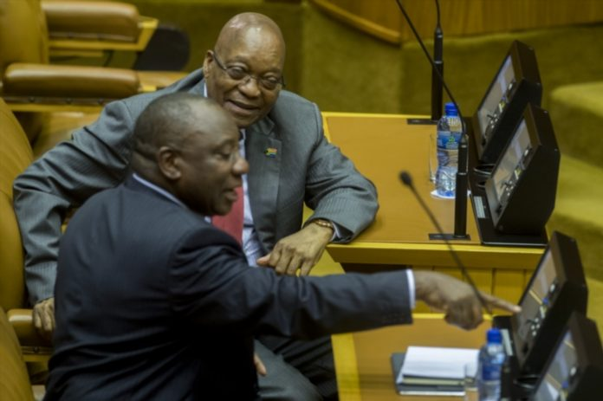
ДЖЕЙКОБ ЗУМА И СИРИЛ РАМАФОСА

Slide 3
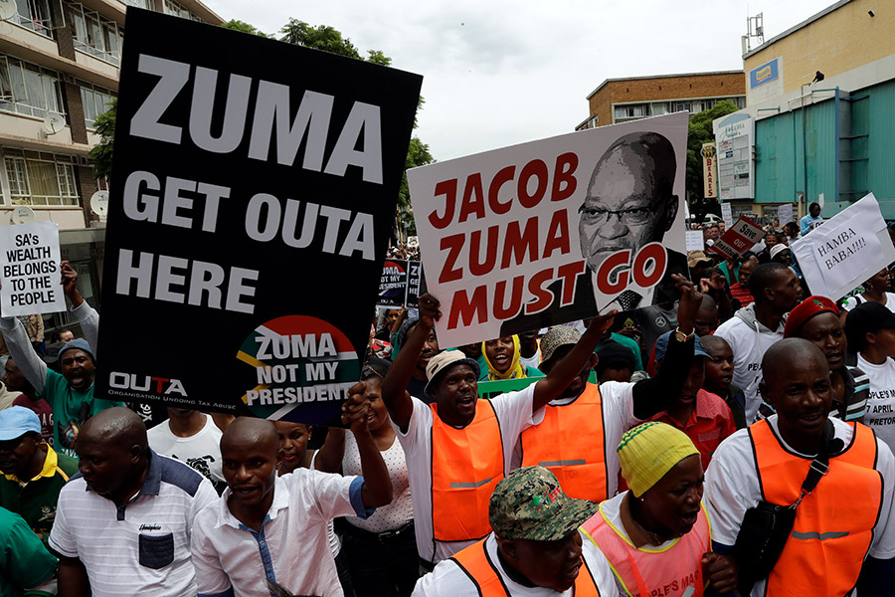
БОРЬБА ЮАР ЗА ОТСТАВКУ ПРЕЗИДЕНТА
It is a very sad reality that SA will not recover, the country has already crossed the point of return...
All I can say is that SA will go down the same route as mazambique, famine, poverty and complete collapse. All the signs are there, you must be blind not to see it…

Slide 4
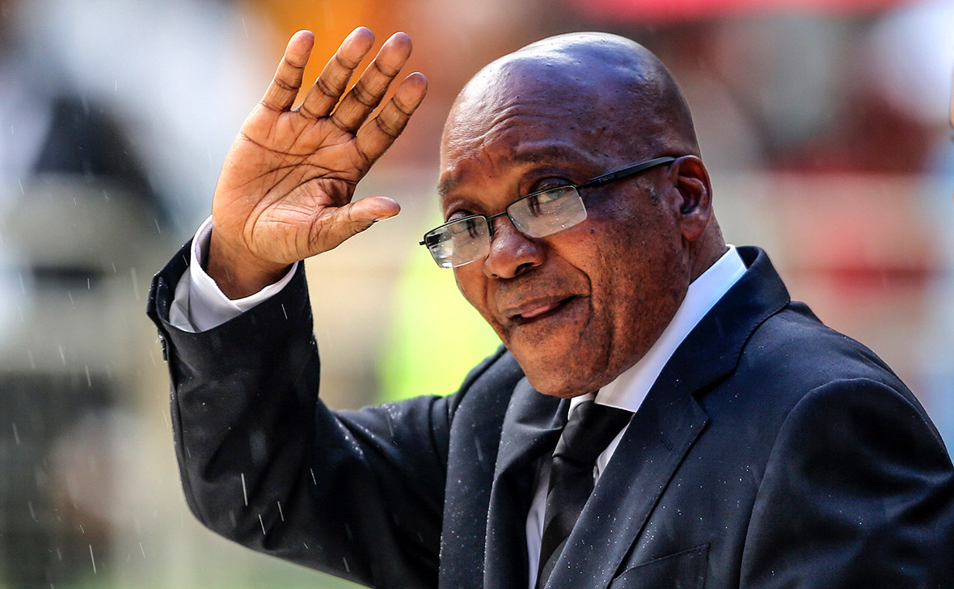
15 ФЕВРАЛЯ 2018 Г.

Slide 5
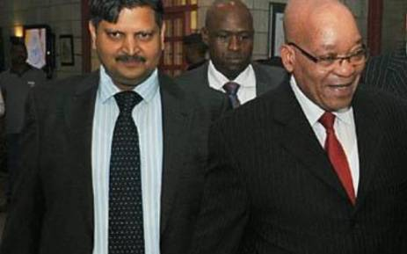
ТЕНЕВЫЕ ПРАВИТЕЛИ ЮАР ВРЕМЕН Д. ЗУМЫ
Семья ГУПТА,
Компания McKinsey

Slide 6
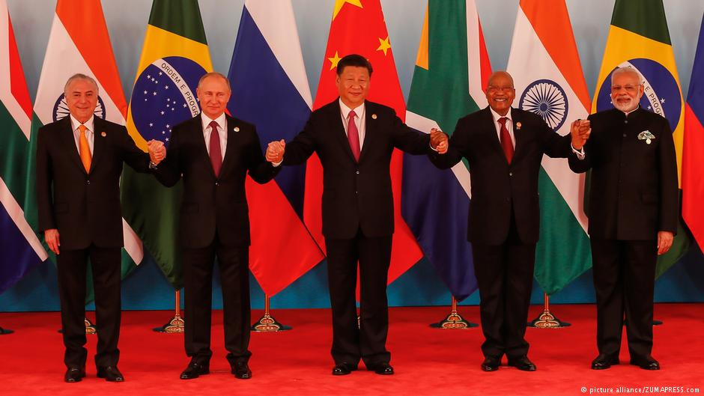
ЮАР И БРИКС: РОМАН, НО С КЕМ?

Slide 7
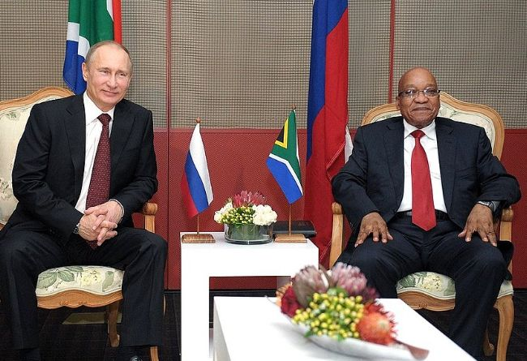
РОССИЯ И ЮАР ДО 14.02.18: РОМАН ПРЕЗИДЕНТОВ

Slide 8
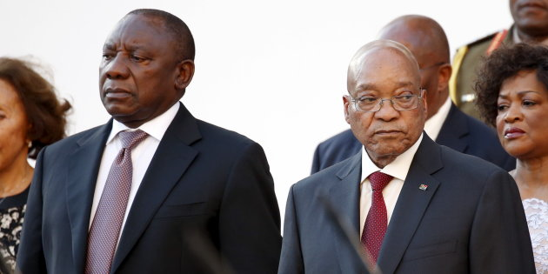
РОССИЯ И ЮАР: КРИЗИС ОФИЦИАЛЬНОЙ ДИПЛОМАТИИ
How Vladimir Putin helped Zuma reshuffle his cabinet 22 October 2017
A team acting on orders from Russian President Vladimir Putin reportedly met President Jacob Zuma just before his surprise cabinet reshuffle.
Several ministers were removed or transferred to new departments in the reshuffle – including David Mahlobo being made the new minister of energy.
According to the Sunday Times, Putin’s team told Zuma to “speed up and conclude a multibillion-dollar nuclear deal with Russia”.
Hours after the meeting, the cabinet reshuffle took place.
“Their visit was to deliver what many of us believe to be the final warning to the South African authorities. This group does not normally leave Russia. These are members of the military, the police, and the intelligence,” a source told the newspaper.
“Mahlobo was chosen by the Russians.”
Zuma vs Ramaphosa: the new cold war 2017-10-23
Deputy President Cyril Ramaphosa's supporters believe he could be charged with treason any day now, with charges relating to his ties to American business and his alleged plans to cut off Russia as a close ally if he becomes president…
24.10.17. The Russian embassy has refuted reports that President Vladimir Putin had a hand in President Jacob Zuma’s cabinet reshuffle last week.
“We are highly disappointed to see yet another example of sensationalism and fake news in South African press‚ especially in an evident attempt to emulate the worst kind of groundless anti-Russian attacks by some of the global mainstream media‚” the embassy said in a statement.
“We consider this (a) slanderous piece‚ which is (as usual) based entirely on hearsay and unnamed sources … One could speculate that only a desperate‚ craving for extra publicity could force a once a reputable outlet (to) resort to tabloid-grade methods.”
The embassy said it was not aware of any Russian delegation coming to South Africa last week‚ as reported in the Sunday Times.

Slide 9
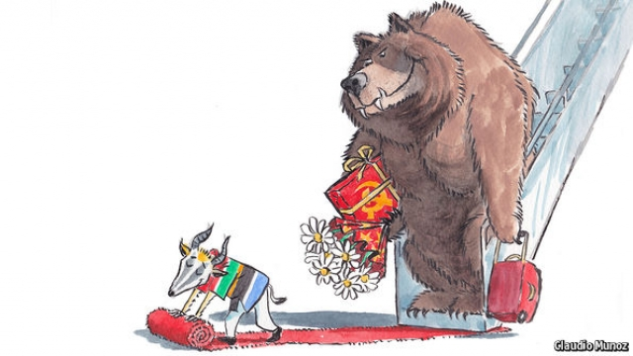
РОССИЯ И ЮАР: КРИЗИС ПУБЛИЧНОЙ ДИПЛОМАТИИ
"This would allow Russia quite extraordinary strategic influence within southern Africa, thereby
achieving Russia’s strategic objectives in the region.«
--------------
«Sad to think how many of our soldiers died fighting these guys to stop this from happening and now here we are…»
«Surely you do not believe this fake news? Russia is the complete opposite from the communist they were through the 70s.»
- «Whether we like it or not - we're going to have a boss.
Let's make that boss our choice while we still can. My choice: any banana will do provided it is NOT the United States or of the European Union. And if Russia has "strategic interests" in south/southern Africa then I already feel a whole lot safer from American bombs. Once those phuckers start bombing you they don't stop.»
«Russia ranked 148th out of 179 countries in the Press Freedom Index from Reporters Without Borders, they jail reporters dude.»
«As much as I am concerned about our corrupt government, I don't believe this. This is fake news at it's best. It sounds wrong... Russia are not aggressive it's America who do things like this or who would come up the fake news like this. Just think about who the competition is and the current wave of ANC corruption.»

Slide 10
РОССИЯ И ЮАР ПОСЛЕ 15.02.18

Slide 11
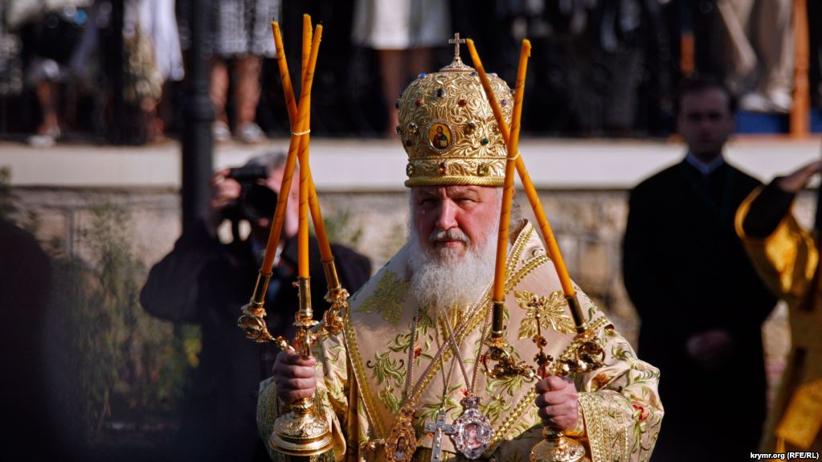
РОССИЯ И ЮАР: КТО ВИНОВАТ И ЧТО ДЕЛАТЬ?

Slide 12
РОЛЬ И МЕСТО ЖЕНЩИН В РФ И ЮАР
Country Score Card | 2006 |  |  |  | 2016
 | Rank |  | Score |  | Rank |  | Score
 | RF | RSA | RF | RSA | RF | RSA | RF | RSA
Global Gender Gap Index | 49 | 18 | 0,677 | 0,713 | 75 | 15 | 0,691 | 0,764
Economic participation and opportunities | 22 | 79 | 0,696 | 0,556 | 41 | 63 | 0,722 | 0,677
Educational attainment | 19 | 42 | 0,999 | 0,993 | 45 | 55 | 0,997 | 0,995
Health and survival | 36 | 59 | 0,979 | 0,976 | 40 | 1 | 0,979 | 0,980
Political empowerment | 108 | 8 | 0,034 | 0,326 | 129 | 13 | 0,066 | 0,404
Источник: http://reports.weforum.org/global-gender-gap-report-2016

